Slide 1
2D Finite Elements
Version 2017.1

Slide 2
Steps of Finite Elements analysis
We can organize the analysis of a generic problem with n-dimension Finite Elements (F.E.) into the following steps:
  Definition of the (differential) equations describing the problem
  Proper choice of the computational domain and its physical properties
  Correct assignment of the B.C.s
  Mesh generation
  Stiffness matrix, mass matrix and constant terms vector construction
  Solution of the obtained linear system
  Solution post-processing (plot, derivation, max/min, interpolation,…)

Slide 3
1. Definition of the differential equations describing the problem
During this part of the course we focus on the (temporal evolution of the) 2D diffusion-transport-reaction problem:
This equation is used to model many physical phenomena, and plays an important role in different fields:
  Mechanics
  Thermodynamics
  Electronics
  …

Slide 4
2-6. Mesh toolbox
For the points 2 to 6 we use a collection of MATLAB functions (“toolbox”) available on the Portale della Didattica. This toolboxprovides a set of low level routine (respect to the ones available with Comsol MultiPhysics, Hypermesh, PDEtool, etc.) to access all the mesh data (vertices, triangles, edges, …) and build the linear system obtained with the F.E. approximation of the given problem.
Since the toolbox contains many folders, to be able to use it regardless of the current MATLAB folder, we need to add it to the MATLAB path, a list of folders that MATLAB scans when searching for a requested function.
For additional details, see “path” and “Function Precedence Order” in the MATLAB help

Slide 5

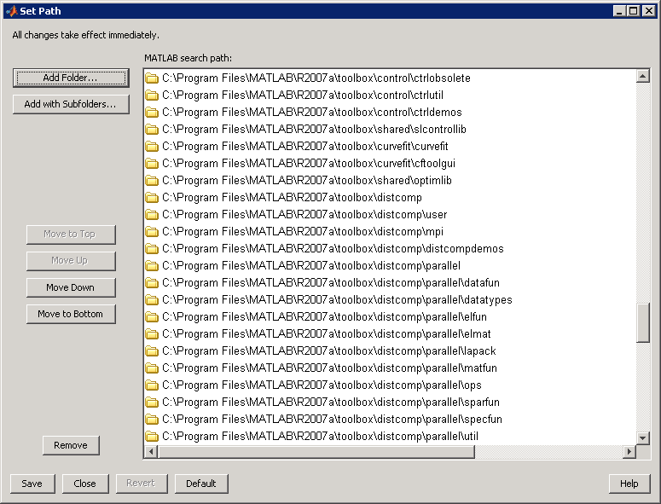

How to install the mesh toolbox
To add the toolbox’s folders to the Search Path:
  Extract the files and folders from the archive
  MeshToolbox.zip to a folder (ex. MeshToolbox)
  In MATLAB, choose File→Set path from the menu
  (version<2012b) or Set Path in the Home Tab
  In the Set Path dialog, press Add with subfolders…
  and select the root extracted folder
    NB: select the extacted folder, not its
    subfolders, since they are automatically
    added using the “Add with subfolders...” option
  In the LAIB, simply close the dialog without saving using the Close button; on your computer choose Save to save the changes (you might need to be an administrator to perform this operation)
Alternatively, once the files have been extracted, change the current folder to MeshToolbox and execute the script setpath.m

Slide 6
MATLAB structures
In MATLAB it is possible to logically regroup heterogeneous data types using a single structure variable
  >> Student.Name='Donald';
  >> Student.ID=313313;
Student is variable of type structure, Name and ID are fields of the structure
We can of course create vectors and matrices of structures:
>> Student(100).Name = 'Mickey';
You can also create a structure using the command struct and specifying couples of name-values:
  >> a=struct('Name','Pap','ID',313);
  >> isfield(a,'Name') %returns true

Slide 7
MATLAB Classes (Advanced topic)
A MATLAB class is similar to a struct but also allows to
  Define properties, and functions (“methods”) acting only on instances of that class (i.e., a variable of such a class)
  Define a “constructor”, which is a function called automatically when you create a variable of that ; this is useful, e.g., to automatically initialize field, set counters to zero, etc)
  Re-define fundamental operators (+, -, *, /, &,…) to allow a more intuitive execution of some commands
All the properties and methods of a class are collected in a file, having the same name as the class, starting with the keyword classdef
The function isa(variable,'classname') returns true when the variable belongs to the class “classname”
In MATLAB all the variables are indeed instances of a class
(class int, class float, class double…)
  >>a=10.5; isa(a,'double') %returns 1

Slide 8
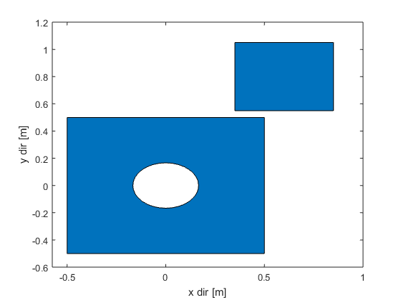
On regions, borders, and edges
We call region a collection of closed regions, eventually with holes. Each region has one or more borders
Each border is formed by a closed sequence of points in the 2D cartesian plane linked together by lines. These connecting lines are called edges.
The code for the definition of
regions is included in region.m.
It allows to
  Create a region from (x,y) coordinates
  Translate, rotate and expand a region
  Calculate the intersections
  between different regions
A region with 2 regions + 1 hole =
3 borders, having 40 edges
(the circular hole is approximated with 32 edges)

Slide 9
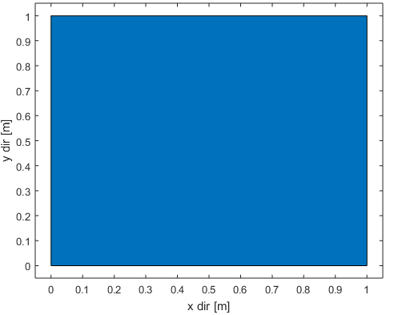
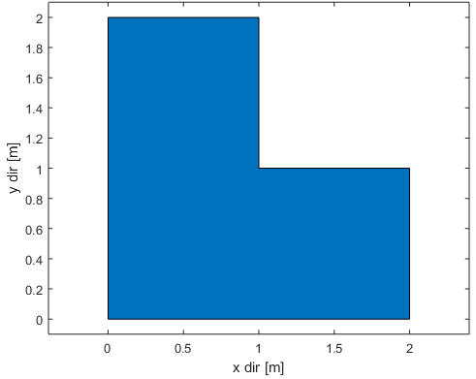
region class: construction
To define an object of class region, simply
call region(xx,yy), where xx and yy are
vectors with the coordinates of the nodes:
  >> region([0,0,1,1],[0,1,1,0]);
  returns a squared region
  >> R=region([0,2,2,1,1,0],[0,0,1,1,2,2]);
  returns a L regiond domain
To build complex regions it is generally
easier to start from the basic regions
available in the class regions
To plot a region, use the draw method of the class:
>> R.draw(); %or draw(R);

Slide 10
Methods of the regions class
regions.rect returns a rectangle
  rect() returns a square with side 1 centered in (0,0)
  rect([x0,y0]) returns a square with side 1 centered in (x0,y0)
  rect([x0,y0],[w,h]) returns a rectangle with base w and heigth h, centered in (x0,y0)
  rectN([x0,y0],[x1,y1]) returns a rectangle given two opposite vertices
Examples:
  >>r=regions.rect();
  >>r=regions.rect([2,3],[3,1]);

Slide 11
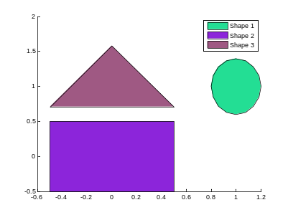
region class: construction
regions.circle() behaves similarly:
  circle() returns a circle with unitary radius centred in the origin, approximated as a polygon with 32 edges
  circle([x0,y0]) returns a circle with unitary radius centred in (x0,y0) , approximated as a polygon with 32 edges
  circle([x0,y0],[a,b]) returns an ellipsis with semi axis a and b and centred in (x0,y0).
  circle([x0,y0],[a,b],n) returns an ellipsis with semi axis a and b and centred in (x0,y0), approximate a n-sided polygon
triangle([x0,y0], side) returns an equilateral triangle given its center of mass and its side
Examples:
  >>r=regions.triangle([0,1],1);
  >>r=regions.rect();
  >>r=regions.circle([1,1],[.2, .4]);

Slide 12
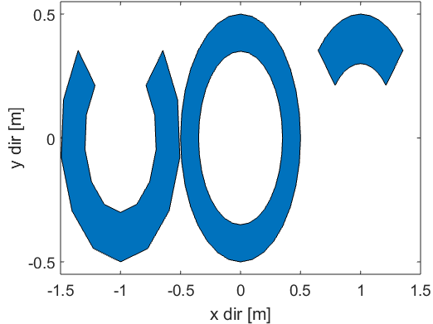
region class: construction
regions.sector returns a (sector of) annulus
>>R=regions.sector(center, extRadius, inRadius, angles, sides)
  center is the center of the circles
  extRadius and inRadius are the inner and outer radius, respectively
  angles is a 2-components vector (in degrees!)
  sides is the number of sides to use to approximate each circumference
Example:
  >>draw(
  regions.sector([-1,0],.5,.3,...
  [135,405],10)+
  regions.sector([0,0],.5)+
  regions.sector([1,0],.5,.3,[45,135],10)
  )

Slide 13
region class: operations
You can change the position of a region object adding a 2 components vector with the x- and y- offsets
  >>r=regions.rect([3,4]);
  >>t=s+[3;4];
It is possible to multiply a region object by a 2-components vector, shrinking or dilating in the x and y directions respectively
>>t=s*[2;2];
>>c=regions.circle()/2;

Slide 14
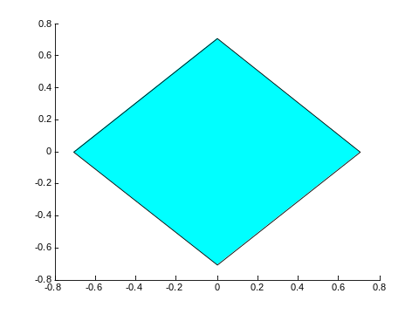
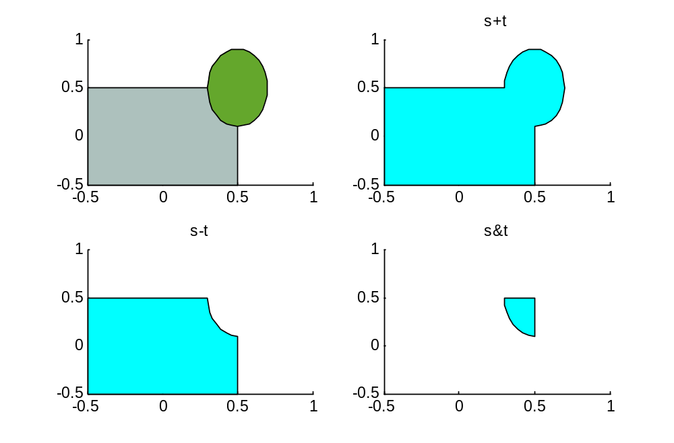
region class: operations
It is possible to rotate a
region using the method
rotate(angle)
>>s=regions.rect().rotate(45);
>>s.draw();
Finally, it is possible to
combine regions using
operators +, -, &
  >> t=regions.circle
  ([0.5,0.5],
  [0.2,0.4],32)
  >> s=regions.rect();
s+t
s-t
s&t

Slide 15
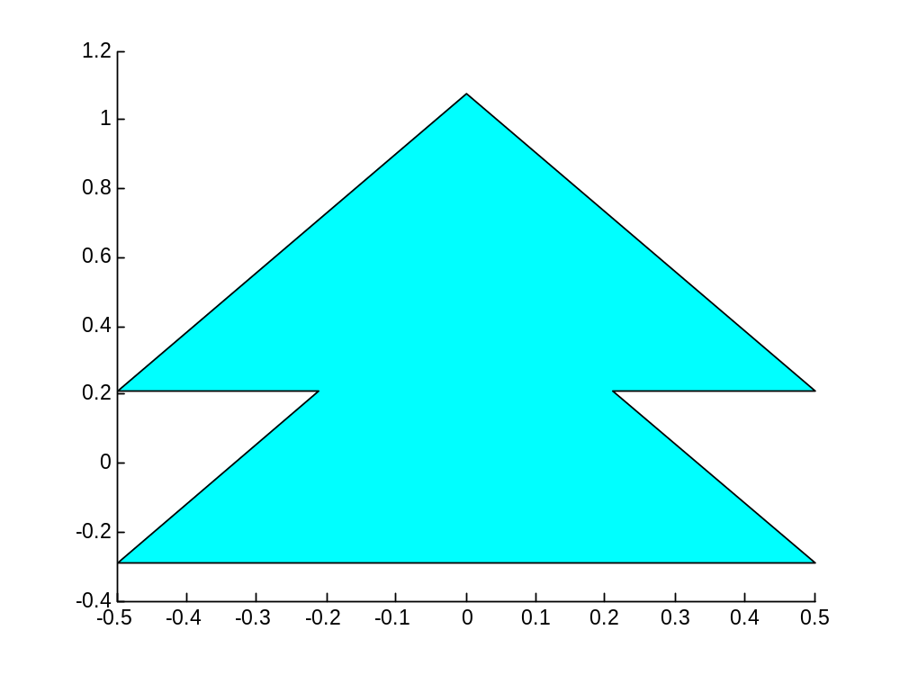
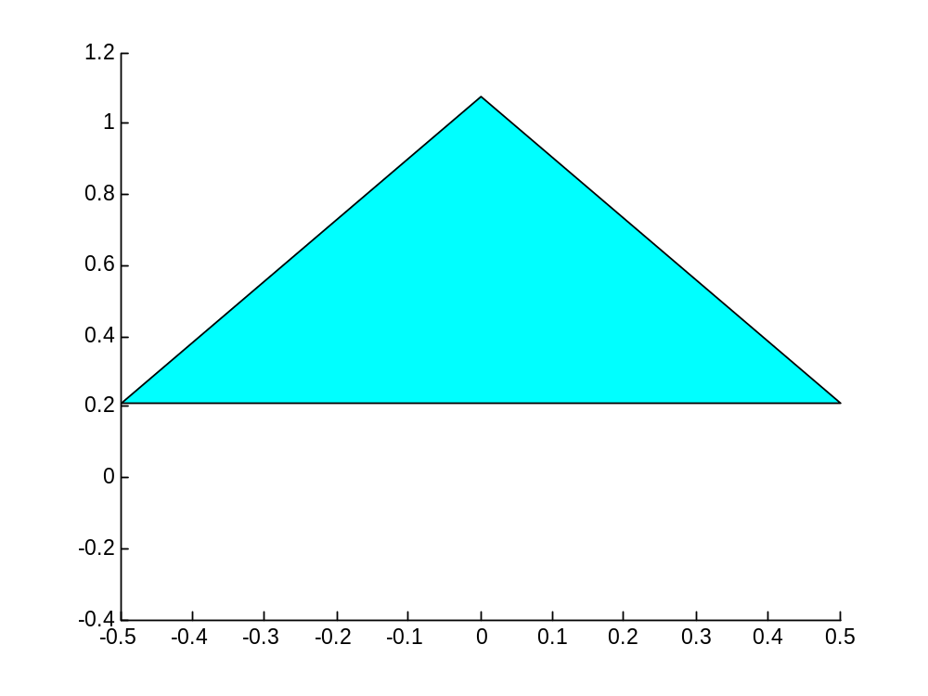
region class: operations
Be carefull with operators precedence!!!
regions.triangle+... regions.triangle+ (regions.triangle+[0,1]) regions.triangle+[0 1]

Slide 16
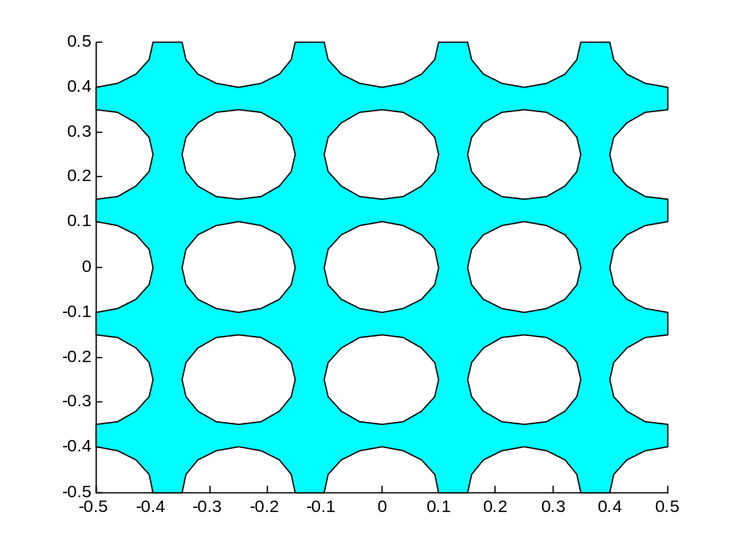
region class: operations
It is then easy to generate regions with holes:
R=regions.rect();
for r=0:4,
for c=0:4,
R=R-regions.circle([r/4-.5,c/4-.5],0.1)
end,
end
R.draw();
The region is made by
10 borders (1 for the outside
and 9 for the internal holes)

Slide 17
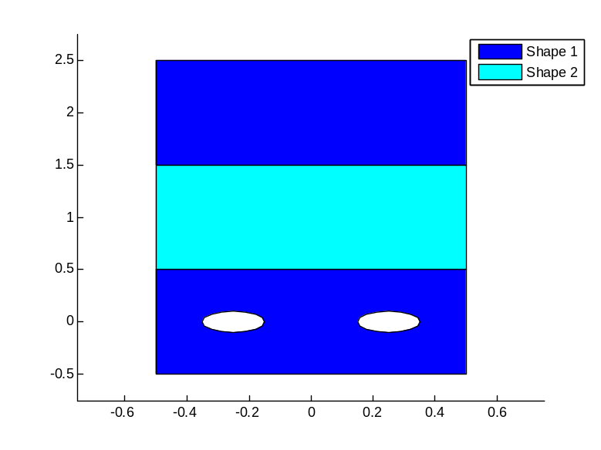
Vectors of region objects
It is possible to define vectors of region objects, used to mesh stratified structures or geometries with different materials
The method draw draws every region with a different color
>>s(1)=regions.rect()-...
regions.circle([-0.25 0],[0.1 0.1])-...
regions.circle([0.25 0],[0.1 0.1])+...
regions.rect([0,2]);
>>s(2)=regions.rect([0,1]);
>>s.draw();
% S(1) has 2 regions, 4 borders
% S(2) has 1 region and 1 border

Slide 18
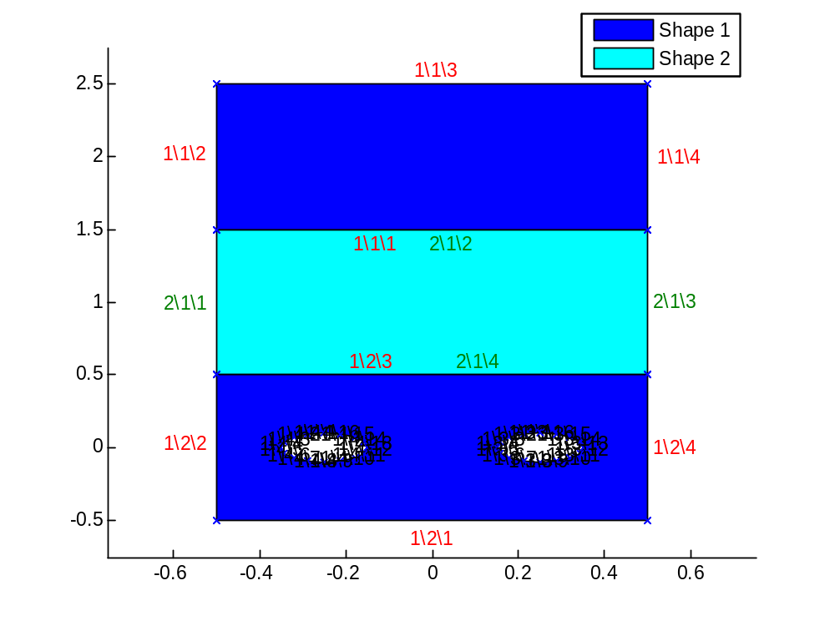
region class: edges numbers
Each edge is uniquely identified; the “address” of each edge can be displayed using
>>Draw(S,'edge')
which indicates on each edge the number of the Region/Border/Edge
For instance, 1/2/3 indicates
that the selected edge is the
3rd of the 2nd Border of Region 1
This edge is coincident with
2/1/4, i.e. the 4th edge of
the 1st Border of region 2

Slide 19
region class: info
Additional info are printed when you type the name of the instance on the prompt
>>R
  1x2 region objects; 8 borders and 144 nodes in total
The method display (region, level) allows to obtain info more or less datailed according to the required “level”: the higher this parameter is (from 1 to 3), the more complete is the description which is printed

Slide 20
region class: info
  >>display(R,3)
  1x1 Region object(s); 10 polygon(s) and 272 node(s) in total
  Region 1: 10 polygon(s)
  Polygon 1: 128 node(s)
  Polygon 2: 16 node(s), hole
  Polygon 3: 16 node(s), hole
  Polygon 4: 16 node(s), hole
  Polygon 5: 16 node(s), hole
  Polygon 6: 16 node(s), hole
  Polygon 7: 16 node(s), hole
  Polygon 8: 16 node(s), hole
  Polygon 9: 16 node(s), hole
  Polygon 10: 16 node(s), hole
Holes

Slide 21
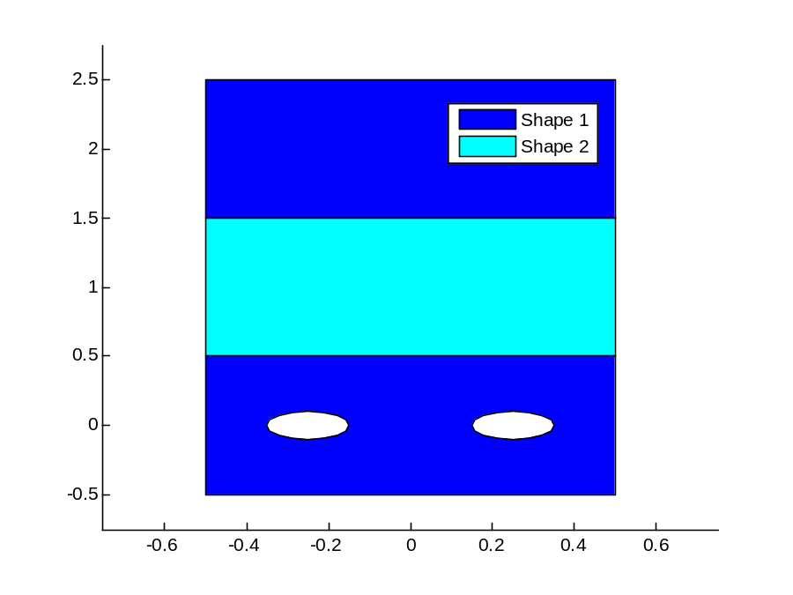
region class: info
  If the first parameter is a vector, this function prints the details of each region:
  >> display(s,2)
  1x2 Region object(s); 5 polygon(s) and 44 node(s) in total
  Region 1: 4 polygon(s)
  mu: 2
  Polygon 1: 4 node(s)
  Polygon 2: 4 node(s)
  Polygon 3: 16 node(s), hole
  Polygon 4: 16 node(s), hole
  Region 2: 1 polygon(s)
  mu: 1
  Polygon 1: 4 node(s)

Slide 22
User defined properties
It is possible to associate user-defined properties to a region, directly when creating it
>>s = regions.rect('elasticity',1,'density',2);
or later:
>>s = regions.rect();
>>s = s.addProperty('elasticity',1);
>>s = s.addProperty('elasticity',@(x,y)x+5*y);
A property must have a MATLAB valid name (no spaces, accents, ets.); it can be expressed as a constant or as a two variables function @(x,y)
It is possible to define an arbitrary number of properties:
  >> s.addProperty(s, 'elasticity',5);
  >> s.addProperty(s, 'density',@(x,y) sin(x)+y);
  >> s.addProperty (s, 'coeff_A',1,'coeff_B',2);

Slide 23
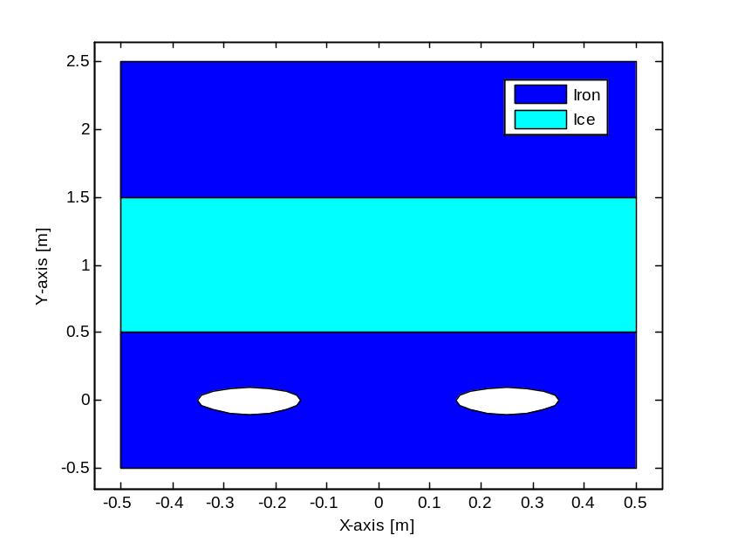
User defined properties
If a property called “name” has been defined, it is used as legend entry
>>s(1)=...
>>s(2)=...
>>s(1)=s(1).addProperty(s(1), 'name', 'Iron');
>>s(2)=s(2).addProperty(s(2), 'name', 'Ice');
>>figure; s.draw;
Another important property is
“MeshMaxArea”, which is the
maximum area of the
triangles generated in that
region

Slide 24
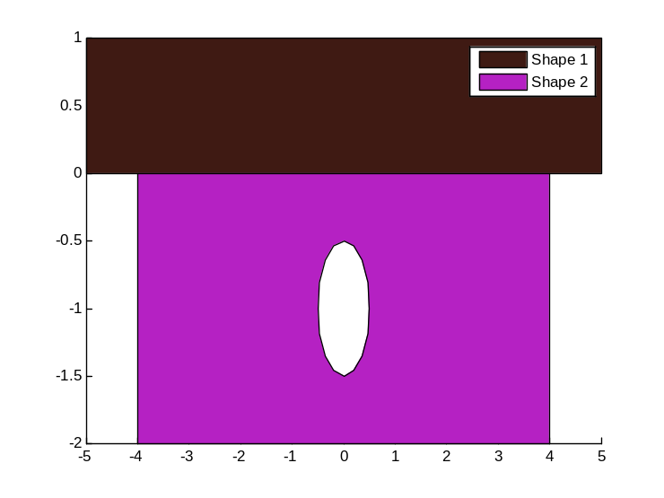
region class: adding a node
In some cases it is important to add one or more points to a pre-existing region
Let’s consider a regions’ vector such as
  >>Sh(1)=regions.rect([0 0.5],[10,1]);
  >>Sh(2)=regions.rect([0 -1],[8,2])-...
  regions.circle([0 -1],0.5);
In order to apply the desired boundary conditions on the two segments indicated with
the arrows, we need to add two
nodes to divide the bottom
side of the largest brown
rectangle

Slide 25
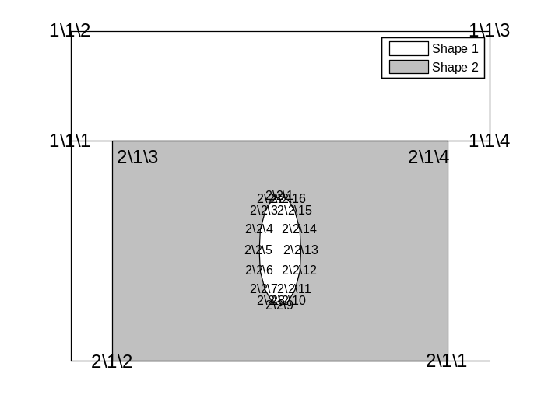
region class: adding a node
To do so, we start by calling the function draw(Sh,'n'), which reports the number of each vertex
In this case we need to add the nodes
[4,0] and [-4,0] after 1\1\4,
that is, the fourth node of the first
border of the first region
We then use the method insertNode
to add the new points
Sh(1).Borders(1)=
Sh(1).Borders(1).insertNode(4,[4 0;-4 0]);
The first input parameter indicates AFTER which vertex we want to add the points, the second one contains a matrix with 2 columns (x,y) and a row for each node to insert

Slide 26
Snap to grid
Numerical rounding errors due to the finite machine precision could generate problems when merging regions
In order to solve this problem, we can define a grid and snap the regions nodes to it.
The grid spacing is defined using grid2D.setSteps(dx,dy) :
  >> grid2D.setSteps (0.01, 0.01);
  >> display(regions.rect([0,0],[sqrt(2), sqrt(2)]),3)
  1x1 Region object(s); 1 polygon(s) and 4 node(s)
  Region 1: 1 polygon(s)
  Polygon 1: 4 node(s)
  -0.7100 -0.7100 0.7100 0.7100
  -0.7100 0.7100 0.7100 -0.7100
grid2D.remove() removes the grid
Initially, and after clear all, the grid step is 1e-10

Slide 27



Boundary conditions
Each edge of each border is associated to a B.C., trough an object of class boundary.
By default, all the edges receive a homogeneous Dirichlet B.C.
We can apply any boundary condition (Dirichlet, Neumann , Robin, Periodic, continuity) using the methods available in the boundaries class:
S(1).Borders(1).Bc(1)=boundaries.dirichlet(3)
S(1).Borders(1).Bc(3)=boundaries.neumann(4)
  S(1).Borders(1).Bc(2)=boundaries.robin(h,g)

Slide 28
Boundary conditions
On the edges belonging to two different regions, we don’t need to impose any condition; the nodes there are simply
unknown, and we ask for the continuity of the
solution
S(2).Borders(1).Bc(2)=...
boundaries.continuity();
Finally, if the geometry we consider is the
elementary cell of a periodic structure,
we may apply periodic solutions to the
borders
S(1).Borders(1).Bc(2)=...
boundaries.periodic(@(x,y)periodic_law);

Slide 29
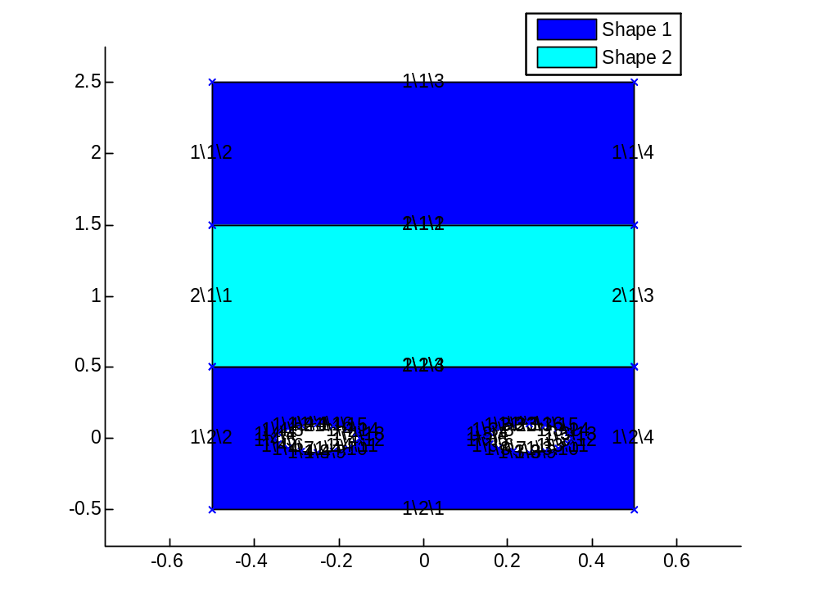
Boundary conditions
You can pass not only constant values
  >>S.Borders(1).Bc(1)=boundaries.dirichlet(3)
  but also functions of (x,y) to obtain position-dependent boundary conditions
  >>S.Borders(1).Bc(3)=boundaries.dirichlet(@(x,y)x+y)
To find the indices of the edges, use s.draw(s,'e')
To assign Omogeneous Neumann conditions on the two cavities, we use
>>b(1).Borders(4).Bc(:)=
boundaries.neumann(0);
>>b(1).Borders(5).Bc(:)=
boundaries.eumann(0);
1/4/*
1/5/*

Slide 30
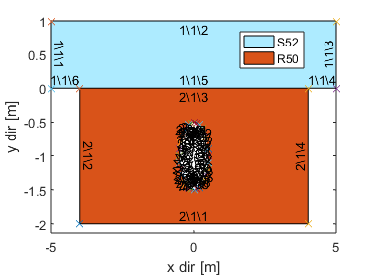
Boundary conditions
To verify if all the boundary conditions were correctly assigned, we call S.draw(Region,'bc')
Sh(1)=regions.rect([0,0.5],[10,1]);
Sh(2)=regions.rect([0,-1],[8,2])-regions.circle([0,-1],0.5);
Sh(1).Borders(1)=...
Sh(1).Borders(1).insertNode(4,[4,0;-4,0]);
figure; Sh.draw('edge');
Sh(1).Borders(1).Bc([2, 4, 6])=boundaries.neumann(0);
Sh(1).Borders(1).Bc(5)=...
boundaries.continuity();
Sh(1).Borders(1).Bc([1, 3])=...
boundaries.periodic(@(x,y)[-x,y]);
Sh(2).Borders(1).Bc([1, 2, 4])=...
boundaries.neumann(0);
Sh(2).Borders(1).Bc(3)=...
boundaries.continuity();
figure; Sh.draw('bc');

Slide 31
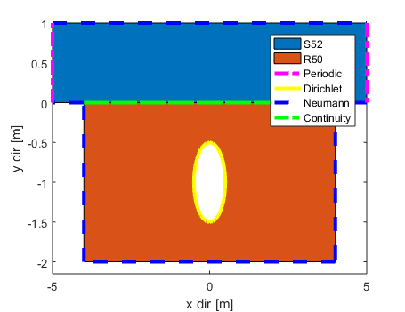
Boundary conditions
In the resulting figure, every side is drawn with a color depending on the applyed boundary condition:
  Yellow: Dirichlet
  Blue: Neumann
  Green: Continuity
  Red: Robin
  Magenta: Periodic
1\1\[2 4 6] Neumann(0)
1\1\5 Continuity
1\1\[1 3] Periodic
2\1\[1 2 4] Neumann(0)
2\1\3 Continuity
Altrove Dirichlet

Slide 32
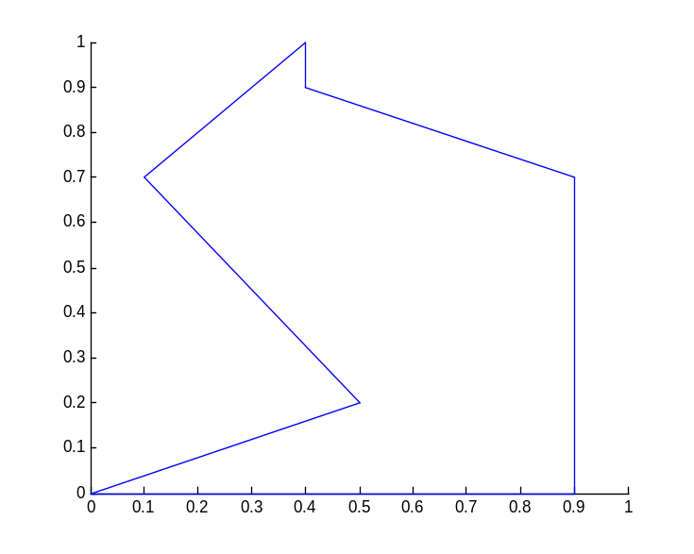
Mesh creation
The software we will use to generate the mesh is based on Triangle, A Two-Dimensional Quality Mesh Generator and Delaunay Triangulator, by J.R. Shewchuk
https://www.cs.cmu.edu/~quake/triangle.html
Let’s consider a generic region
defined by its coordinates:
coord=[ 0, 0;
.5,.2; .1,.7;
.4, 1; .4,.9;
.9,.7; .9, 0];
The region object is created as
  >>s=region(coord(:,1),coord(:,2));
4
5
3
6
2
1
7

Slide 33
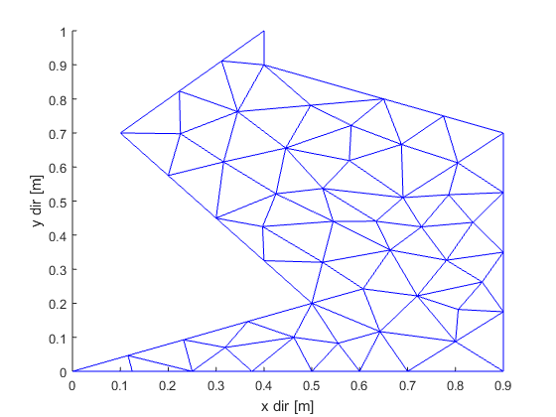
Mesh creation
To build a triangular mesh with homogeneous Dirichlet boundary conditions and with a maximum triangle area equal to 0.01 it is sufficient to call the function Mesh as:
  >>Me=mesh2D(s,0.01);
Me is an instance of the
mesh2D class, implemented
in mesh2D.m
The method Me.draw
allows to draw the result

Slide 34
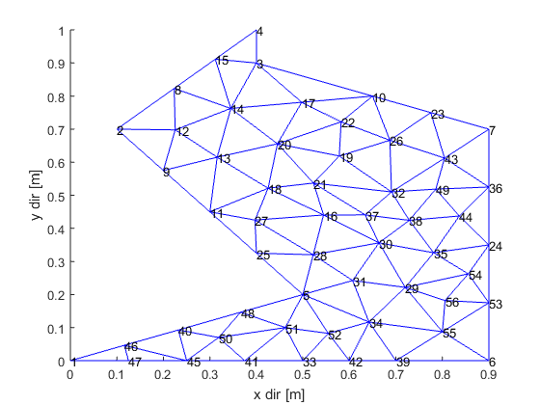
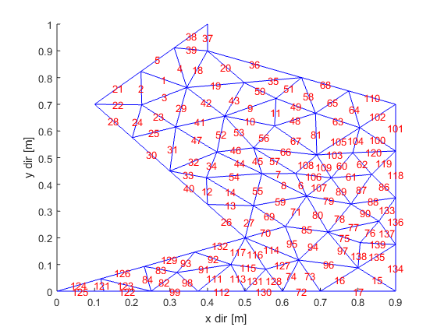
Nodes and edges numbering
Nodes
Me.draw('n')
Edges
Me.draw('e')

Slide 35
Mesh2D object properties
  >>Me
  Nodes: [1x1 struct]
  Triangles: [1x1 struct]
  Edges: [139x2 double]
  BC: [1x1 struct]
  MatrixContributions: 424
  Time: [0 0]
  Regions: [1x1 region]
X: [56x1 double]
Y: [56x1 double]
Dof: [56x1 double]
TwinNode: [56x1 double]
  Vertices: [84x3 double]
  CenterOfMass: [1x1 struct]
  Areas: [84x1 double]
  Region [84x1 double]
DirichletNodes:[26x2 double]
NeumannEdges: [0x2 double]
RobinEdges: [0x3 double]

Slide 36
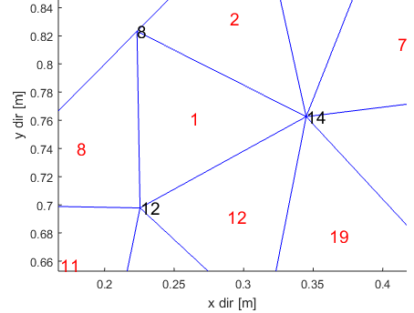
Me.Nodes.X [56,1],
Me.Nodes.Y [56,1]
Me.Nodes contains information about the triangles vertices; it’s a struct with fields X, Y, Dof, TwinNode
Me.Nodes.X and Me.Nodes.Y are column vectors, storing in each row the x and y coordinate of a mesh node. In this case, they have 56 rows→we are dealing with 56 nodes
  >>[Me.Nodes.X(14), Me.Nodes.Y(14)]
  ans= 0.3450 0.7626
The field Me.Nodes.TwinNode is
used to identify the nodes (in the global
numbering) which belongs to edges
with periodic boundary conditions

Slide 37
Me.Nodes.Dof [56x1]
The nodes can be divided into two different groups:
  nodes belonging to edges with Dirichlet boundary conditions, where the solution of the problem is already known
  nodes belonging to the inner part of the domain, or lying on an edge with Neumann/Robin/Periodic B.C.s: they are degrees of freedom to our problem, also called “unknown nodes”
To build the stiffness and mass matrices we need a numbering covering only the unknown nodes: this second numbering is saved in the column vector Me.Nodes.Dof
  For each node k lying on an edge with a Dirichlet boundary condition, in Me.Nodes.Dof(k) is a negative integer referring to a row in Me.Bc.DirichletNodes
  Otherwise, the solution in the node is unknown and we find a progressive integer greater than zero.

Slide 38
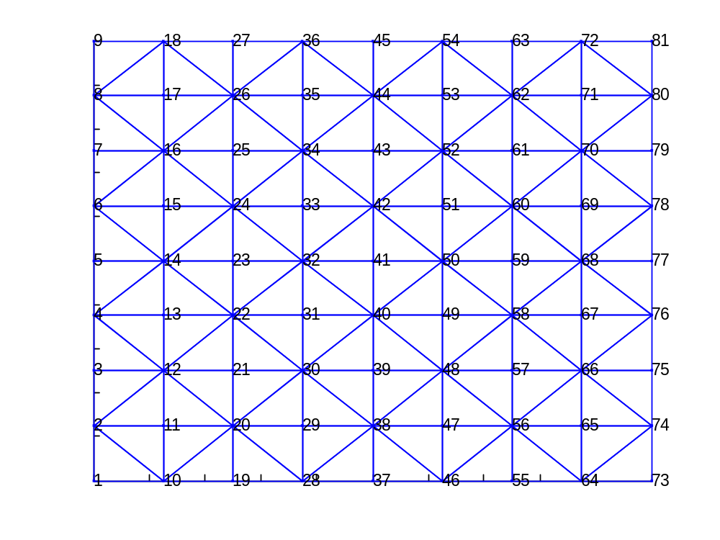
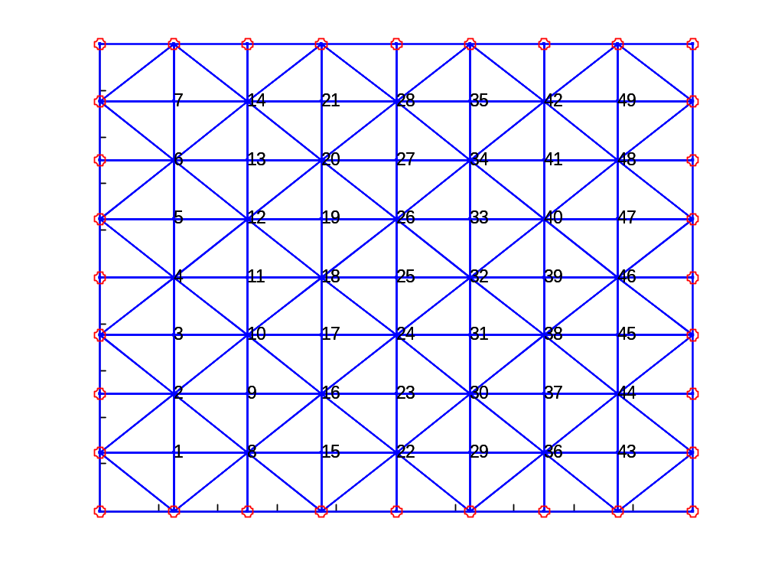
Me.Nodes.Dof [56x1]
The vector length is the number of nodes in the mesh
  For each node k lying on an edge with a Dirichlet boundary condition, in Me.Nodes.Dof(k) is a negative integer referring to a row in Me.Bc.DirichletNodes
  Otherwise, the solution in the node is unknown and we find a progressive integer greater than zero
Global numbering
Dof numbering

Slide 39
Me.Nodes.Dof [56x1]
Therefore:
  If Me.Nodes.Dof(12)=1, then I know that node 12 is a dof and in the new numbering it became node 1
  If Me.Nodes.Dof(18)=-11, then I know that node 18 is on a Dirichlet edge
How many total unknown nodes are there?
>>N_i=max(Me.Nodes.Dof)
How many known (Dirichlet) nodes are there?
>>min(Me.Nodes.Dof)
>>length(Me.Nodes.Dof)-N_i

Slide 40
Me.Triangles.Vertices [84x3]
It contains information about the triangles; it’s a struct with fields Vertices, CenterOfMass, Area, Region
Me.Triangles.Vertices returns the indices of the 3 vertices of each triangle, in the global numbering; in this case it has 84 rows→we are dealing with 84 triangles
>>Me.Triangles.Vertices(1,:)‏
ans= 14 8 12
  means that the triangle 1 vertices
  are the nodes 14, 8 and 12
  What are the x-coordinates of the 3rd triangle’s vertices ?
  >>Me.Nodes.X(Me.Triangles.Vertices(3,:))
Vertices numbers

Slide 41
Me.Triangles.CenterOfMass, Me.Triangles.Areas [84,1], Me.Triangles.Regions [84,1]
Me.Triangles.CenterOfMass is a struct with 2 fields, x and y, containing two vectors with the x- and y- coordinates of the triangles center of mass
>> Me.Triangles.CenterOfMass.X(1) % 0.2645
>> Me.Triangles.CenterOfMass.Y(1) % 0.7612
Me.Triangles.Areas is a column vector which contains the areas of the triangles
>> Me.Triangles.Areas(1) % 0.0076
Me.Triangles.Regions is a column vector: each element indicates the index of the region the triangle belongs to. This is particularly useful to obtain the physical properties associated to each triangle trough its region.

Slide 42
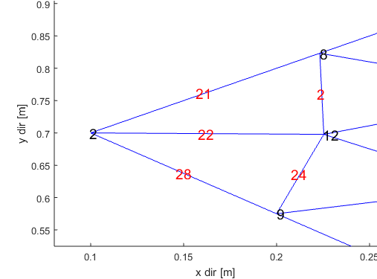
Me.Edges: [139x2 double]
The matrix in Me.Edges indicates,
in each row, the indices of the
vertices connected by that edge
  >>Me.Edges(22,:)
  ans= 2 12
What is the length of edge 28?
V=Me.Edges(28,:); %13 14
X1=Me.Nodes.X(V(1)); %0.5252
X2=Me.Nodes.X(V(2)); %0.6991
Y1=Me.Nodes.Y(V(1)); %0.3879
Y2=Me.Nodes.Y(V(2)); %0.5602
l=sqrt((X2-X1)^2+(Y2-Y1)^2); %0.2448
or, in a more compact way:
l=norm([diff(Me.Nodes.X(V)), diff(Me.Nodes.Y(V))])

Slide 43
Me.Time, Me.MatrixContributions, Me.Regions
The property Me.Time indicates the time required to generate the mesh (1st element) and to assign the BC.s
(2nd elements)
Me.MatrixContributions is the number of non zero elements in the stiffness matrix, for the considered BC.s
Me.Regions is just a backup copy of the Region objects passed as input to mesh2D

Slide 44
Me.BC.DiricheletNodes
[26x2 double]
    The property Me.BC contains info about the applied B.C.s
    Me.BC.DiricheletNodes is a 2-columns matrix. The 1st column contains the indices, in the global numbering, of the nodes on edges with Dirichlet BC.s; the 2nd column contains the values of the Dirichlet BC.:
    If we have:
  [ 1 4 %non homog. Dirichlet
  2 4 %non homog. Dirichlet
  10 0 %homog. Dirichlet
  18 0...] %row 11: the 11th Dirichlet node is node 18 in the global numbering.
    then we have Me.Nodes.Dof(1)=-1, Me.Nodes.Dof(18)=-4, since they aren’t dofs

Slide 45
Me.BC.NeumannEdges, Me.BC.RobinEdges
The property Me.BC.NeumannEdges contain on the first column the indices of the triangle edges which present a Neumann boundary conditions. The second column contains the values of the boundary conditions evaluated in the centre of each edge
The property Me.BC.RobinEdges contain on the first column the indices of the triangle edges which present a Robin boundary condition. The second and third columns contain the values of the g and h coefficients in the center of each edge

Slide 46
Triangles size and refinement
The maximum triangle area is calculated as follows:
  IF the property MeshMaxArea has been defined, then the value is used for that region
  ELSE IF a second parameter (positive scalar) is passed to mesh2D, then it is used as maximum triangle area
  ELSE the program uses as maximum triangle’s area 1/25 of the area of the rectangle enclosing all the passed regions
(Optional) After the first mesh has been evaluated, the mesh is refined using the refining function provided as second parameter to mesh2D. The function must accept two input vectors (x and y coordinates) and return the maximum desired area in the provided points.

Slide 47
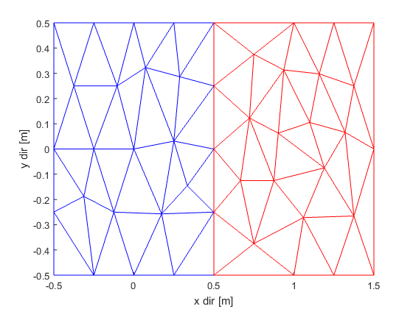
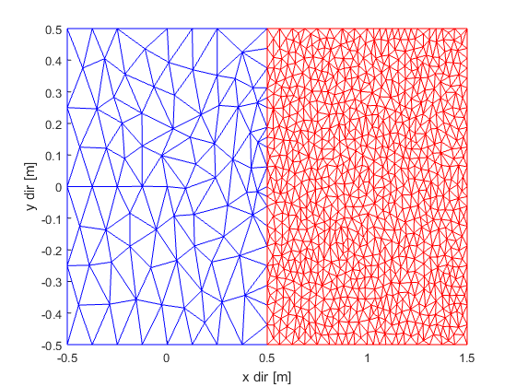
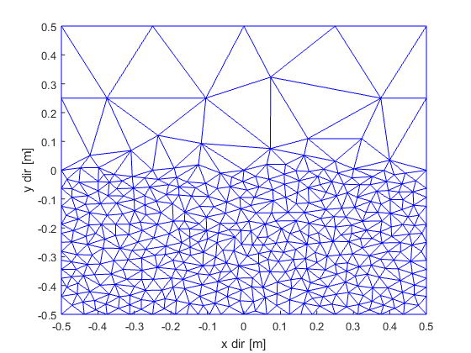
Triangles size and refinement
Example 1
  s(1)=regions.rect();
  s(2)=regions.rect()+[1,0];
  Me=mesh2D(s);
  max(Me.Triangles.Areas) %0.0400
Example 2
  s(1)=regions.rect('MeshMaxArea',1e-2);
  s(2)=regions.rect()+[1,0];
  Me=mesh2D(s,1e-3); %used in s(2)
  T=Me.Triangles;
  max(T.Areas(T.Region==1)) %0.0098
  max(T.Areas(T.Region==2)) %9.9986e-04
Example 3
  s=regions.rect();
  Me=mesh2D(s,@(x,y)1-0.999*(y<0));
  %1 if y>=0, 0.0001 if y<0

Slide 48
InRect and InCircle functions
The function InRect can simplify the functions used for the refinement
f=@(x,y)(4.*(x<-.5).*(x>-1.5).*(abs(y)<.5)
-1.*(x>.5).*(x<1.5).*(abs(y)<.5))
It returns 1 if the point (x,y) falls in the region centered in
(xc, yc) and with amplitudes w, h:
xyc1=[-1 0]; %1st rectangle center
xyc2=[1 0]; %2nd rectangle center
wh=[1,1]; %width and heigth
f=@(x,y)4*InRect([x,y],xyc1,wh)-InRect([x,y],xy2,wh);
%insted of f=@(x,y)(4.*(x<-.5).*(x>-1.5).*(abs(y)<.5)
% -1.*(x>.5).*(x<1.5).*(abs(y)<.5))
The function InCircle(point, center, radius) behaves similarly:
InCircle([1,1],[0,0],1) → ans = 0
InCircle([1,1],[0,0],5) → ans = 1

Slide 49
Triangles size and refinement
When a complex refining is required, it can be useful to write a function stored in a m-file, e.g.:
  function s = MyRaf(x,y)
  s=0.1*ones(size(x)); %default value
  for k=1:length(x) %loop over the nodes
  if x(k)<0.5 & y(k)>1
  s(k)=0.05
  elseif x(k)>1
  s(k)=0.01
  end
  end
  And the pass it to mesh2D:
  Me = mesh2D(S,@MyRaf);

Slide 50
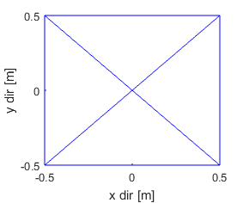
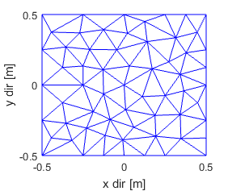
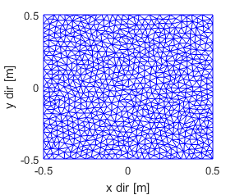
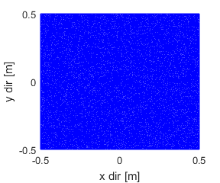
Triangles size and refinement
The time required to calculate the mesh depends on the geometry and on the maximum area
sizes=2.^-(2:16); Sh=regions.rect();
Nrep=10;%repeat for better estimate of time
for k=1:length(sizes),
for rep=1:Nrep
tic; Me=mesh2D(Sh, sizes(k)); time(k)=toc;
end
tr(k)=size(Me.Triangles.Vertices,1);
end
edge=2^-2
edge=2^-6
edge=2^-10
edge=2^-14

Slide 51
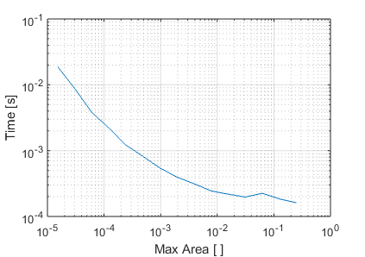
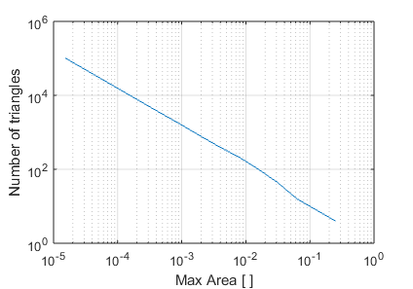
Triangles size and refinement
figure; loglog(sizes,time/Nrep)
xlabel('Max Area [ ]');ylabel('Time [s]');
figure; loglog(sizes,tr); grid on;
xlabel('Max Area [ ]');ylabel('# of triangles [s]');

Slide 52
draw method
It allows to draw the result of a mesh
  >>Me.draw();
In order to draw other useful quantities, you can pass a string as second argument:
  'edge', 'e' to visualize the sides’ numbering
  'node', 'n' to visualize the edges’ numbering
  'triangle', 't', to visualize the triangles’ numbering
  'internalnode','i' to visualize the unknown nodes’ numbering
  'dirichlet','d' , to visualize the known nodes’ numbering
Additional parameters will be introduces after the stiffness matrix construction

Slide 53
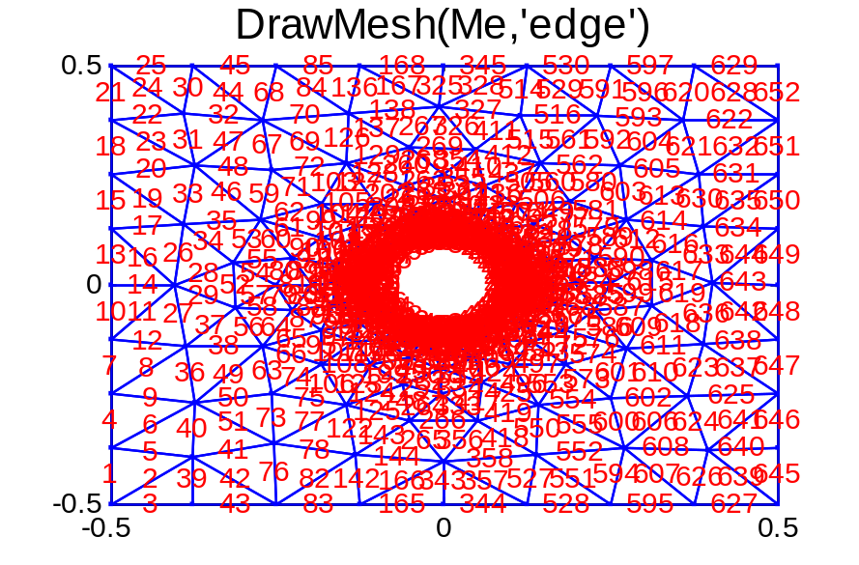
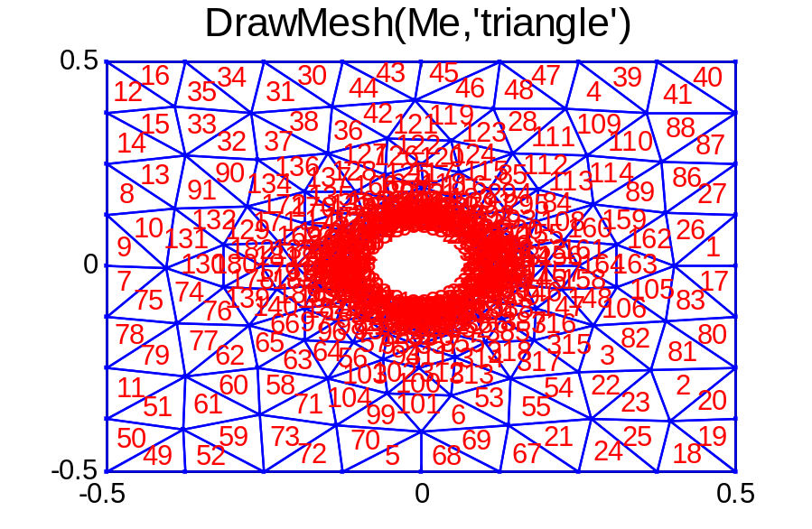
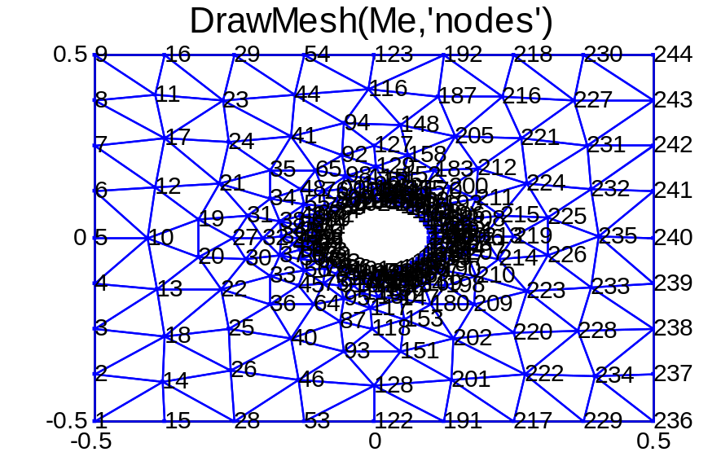
draw method
Me.draw('e')
Me.draw('t')
Me.draw('n')

Slide 54
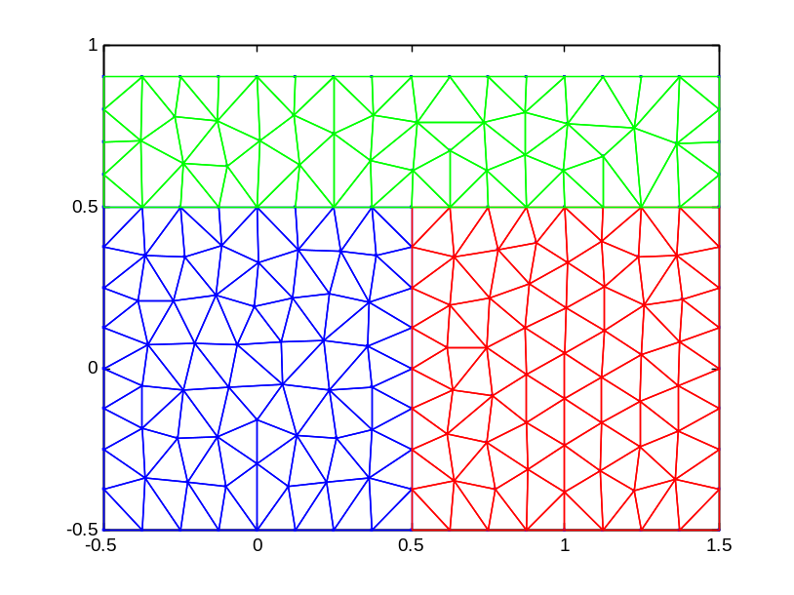
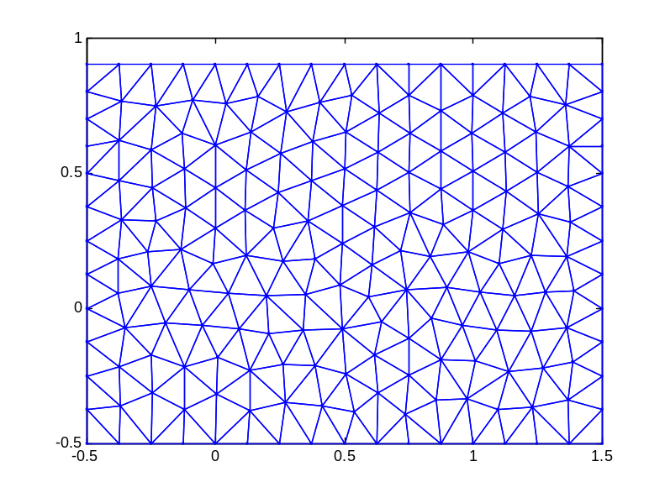
Mesh of a regions’ vector
If you pass to the function mesh2D a vector of regions (=different materials), you obtain the mesh of all the regions
s(1)=regions.rect();
s(2)=regions.rect([1,0]);
s(3)=regions.rect([.5,.7],[2 .4])
Me=Mesh(s); Draw(Me);
s=regions.rect()+
regions.rect([1,0])+
regions.rect([.5,.7],[2,.4]);
Me=Mesh(s); Draw(Me);

Slide 55
Exercise #1
Given the region S=regions.rect(), assuming a maximum triangle area=1e-3
  Calculate the average perimeter of the triangles
  Calculate the average length of the edges
  Calculate the number of nodes lying in a circle with center in the origin and radius 0.5
  Calculate the average distance of the centers of mass with respect to the point (2,3)
  Generate the histogram of the triangles areas (see function hist in MATLAB)

Slide 56
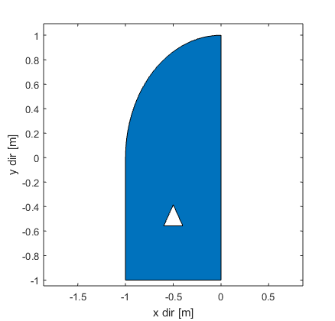
Exercise #2
Generate the region reported on the right, generate a mesh with a suitable max triangle area and calculate the total area of the region
Hint: generate a circle, then remove its right and bottom parts, then add a square below, finally subtract the triangle

Slide 57

Exercise #3
Let’s consider a squared domain 1m x 1m, representing the horizontal section of a chimney. In the centre of the domain we have a circular pipe (external radius: 25cm, internal radius: 15cm) whose internal border has a temperature of 40°C (smoke temperature).
The chimney is isolated on two opposite edges (Homogeneous Neumann B.C.), while on the two other edges we a Robin B.C. with T∞=10°C and a Dirichlet B.C. with T0=10°C.
Describe the domain in terms of region objects and assign the correct B.C.s; then mesh the domain using a maximum triangle area Tmax=1e-4
R
N
D
25 cm
N
10 cm
1 m
D

